Slide 1
Chapter 5
Normalization of Database Tables

Slide 2
Database Tables and Normalization
Normalization is a process for assigning attributes to entities. It reduces data redundancies and helps eliminate the data anomalies.
Normalization works through a series of stages called normal forms:
  First normal form (1NF)
  Second normal form (2NF)
  Third normal form (3NF)
  Fourth normal form (4NF)
The highest level of normalization is not always desirable.

Slide 3
Database Tables and Normalization
The Need for Normalization
  Case of a Construction Company
    Building project -- Project number, Name, Employees assigned to the project.
    Employee -- Employee number, Name, Job classification
    The company charges its clients by billing the hours spent on each project. The hourly billing rate is dependent on the employee’s position.
    Periodically, a report is generated.
    The table whose contents correspond to the reporting requirements is shown in Table 5.1.

Slide 4


Scenario
A few employees works for one project.
Project Num : 15
Project Name : Evergreen
Employee Num : 101, 102, 103, 105

Slide 5
Sample Form
Project Num : 15
Project Name : Evergreen
Emp Num | Emp Name | Job Class | Chr Hours | Hrs Billed | Total
101
102
103
105

Slide 6
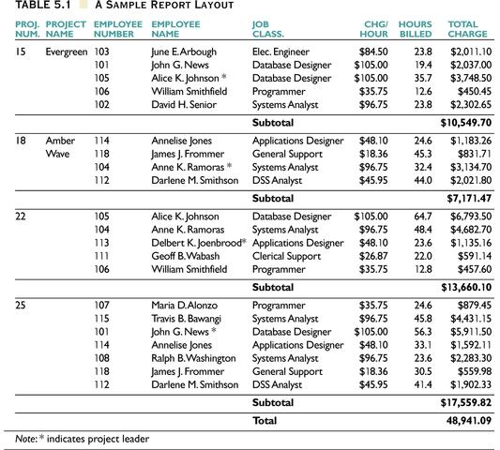

Slide 7
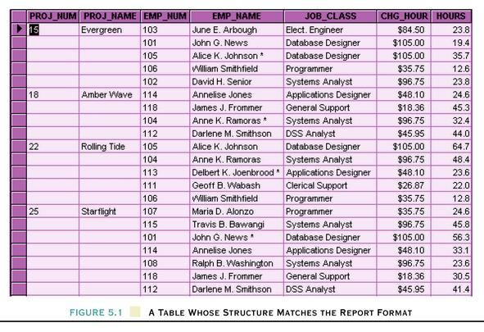
Table Structure Matches
the Report Format

Slide 8
Database Tables and Normalization
Problems with the Figure 5.1
  The project number is intended to be a primary key, but it contains nulls.
  The table displays data redundancies.
  The table entries invite data inconsistencies.
  The data redundancies yield the following anomalies:
    Update anomalies.
    Addition anomalies.
    Deletion anomalies.

Slide 9
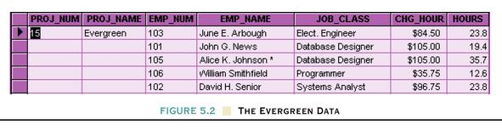
Database Tables and Normalization
Conversion to First Normal Form
  A relational table must not contain repeating groups.
  Repeating groups can be eliminated by adding the appropriate entry in at least the primary key column(s).

Slide 10
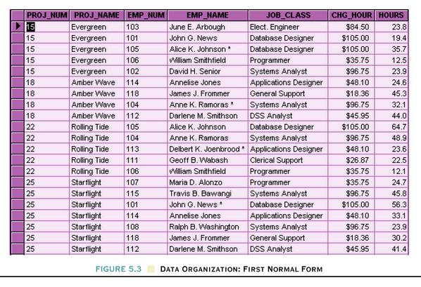
Data Organization: First Normal Form
After
Before

Slide 11
First Normal Form (1 NF)
1NF Definition
  The term first normal form (1NF) describes the tabular format in which:
    All the key attributes are defined.
    There are no repeating groups in the table.
    All attributes are dependent on the primary key.

Slide 12
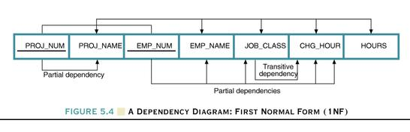
Dependency Diagram
Dependency Diagram
  The primary key components are bold, underlined, and shaded in a different color.
  The arrows above entities indicate all desirable dependencies, i.e., dependencies that are based on PK.
  The arrows below the dependency diagram indicate less desirable dependencies -- partial dependencies and transitive dependencies.

Slide 13
Second Normal Form (2 NF)
Conversion to Second Normal Form
  Starting with the 1NF format, the database can be converted into the 2NF format by
    Writing each key component on a separate line, and then writing the original key on the last line and
    Writing the dependent attributes after each new key.
    PROJECT (PROJ_NUM, PROJ_NAME)
    EMPLOYEE (EMP_NUM, EMP_NAME, JOB_CLASS, CHG_HOUR)
    ASSIGN (PROJ_NUM, EMP_NUM, HOURS)

Slide 14
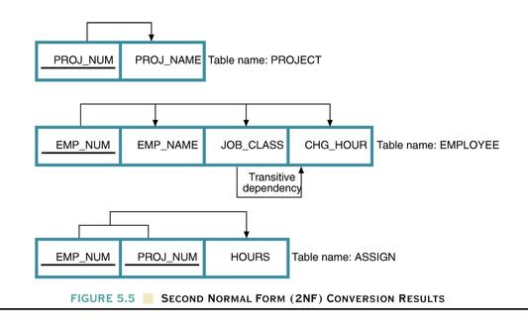
Dependency Diagram

Slide 15
Second Normal Form (2 NF)
A table is in 2NF if:
    It is in 1NF and
    It includes no partial dependencies; that is, no attribute is dependent on only a portion of the primary key.
    (It is still possible for a table in 2NF to exhibit transitive dependency; that is, one or more attributes may be functionally dependent on nonkey attributes.)

Slide 16
Third Normal Form (3 NF)
Conversion to Third Normal Form
  Create a separate table with attributes in a transitive functional dependence relationship.
    PROJECT (PROJ_NUM, PROJ_NAME)
    ASSIGN (PROJ_NUM, EMP_NUM, HOURS)
    EMPLOYEE (EMP_NUM, EMP_NAME, JOB_CLASS)
    JOB (JOB_CLASS, CHG_HOUR)

Slide 17
Third Normal Form (3 NF)
3NF Definition
  A table is in 3NF if:
    It is in 2NF and
    It contains no transitive dependencies.

Slide 18
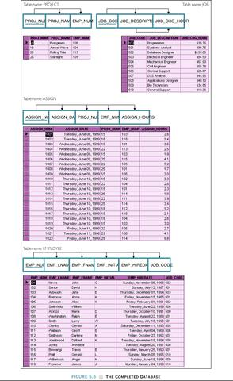
The Completed Database

Slide 19
Boyce-Codd Normal Form (BCNF)
  A table is in Boyce-Codd normal form (BCNF) if every determinant in the table is a candidate key.
    (A determinant is any attribute whose value determines other values with a row.)
  If a table contains only one candidate key, the 3NF and the BCNF are equivalent.
  BCNF is a special case of 3NF.
  Figure 5.7 illustrates a table that is in 3NF but not in BCNF.
  Figure 5.8 shows how the table can be decomposed to conform to the BCNF form.

Slide 20
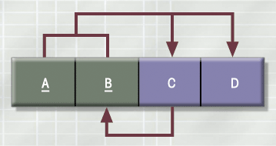
A Table That Is In 3NF
But Not In BCNF

Slide 21
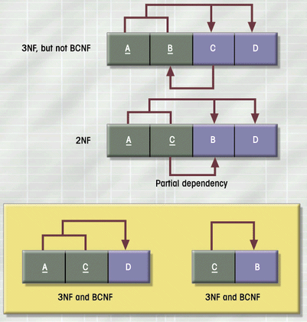
The Decomposition of a Table Structure
to Meet BCNF Requirements

Slide 22
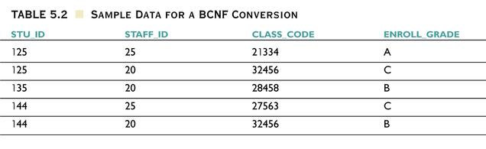
Sample Data for a BCNF Conversion

Slide 23
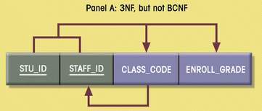
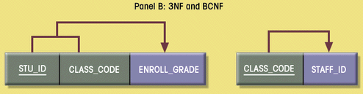
Decomposition into BCNF

Slide 24
BCNF Definition
BCNF Definition
  A table is in BCNF if every determinant in that table is a candidate key. If a table contains only one candidate key, 3NF and BCNF are equivalent.

Slide 25
Normalization
  Normalization will help us identify correct and appropriate TABLES.
  Until Now we have 4 tables
    PROJECT (PROJ_NUM, PROJ_NAME)
    ASSIGN (PROJ_NUM, EMP_NUM, HOURS)
    EMPLOYEE (EMP_NUM, EMP_NAME, JOB_CLASS)
    JOB (JOB_CLASS, CHG_HOUR)

Slide 26
NEXT ........
  We are going to identify the relationships between entities (tables) including their cardinality, connectivity.
  We have to list out the Business Rules.
    PROJECT (PROJ_NUM, PROJ_NAME)
    ASSIGN (PROJ_NUM, EMP_NUM, HOURS)
    EMPLOYEE (EMP_NUM, EMP_NAME, JOB_CLASS)
    JOB (JOB_CLASS, CHG_HOUR)

Slide 27
Business Rules
    The company manages many projects.
    Each project requires the services of many employees.
    An employee may be assigned to several different projects.
    Some employees are not assigned to a project and perform duties not specifically related to a project. Some employees are part of a labor pool, to be shared by all project teams.
    Each employee has a (single) primary job classification. This job classification determines the hourly billing rate.
    Many employees can have the same job classification.

Slide 28
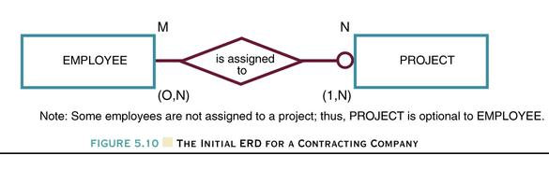
Normalization and Database Design
Two Initial Entities:
    PROJECT (PROJ_NUM, PROJ_NAME)
    EMPLOYEE (EMP_NUM, EMP_LNAME, EMP_FNAME, EMP_INITIAL, JOB_DESCRIPTION, JOB_CHG_HOUR)

Slide 29
Normalization and Database Design
Three Entities After Transitive Dependency Removed
    PROJECT (PROJ_NUM, PROJ_NAME)
    EMPLOYEE (EMP_NUM, EMP_LNAME, EMP_FNAME, EMP_INITIAL, JOB_CODE)
    JOB (JOB_CODE, JOB_DESCRIPTION, JOB_CHG_HOUR)

Slide 30
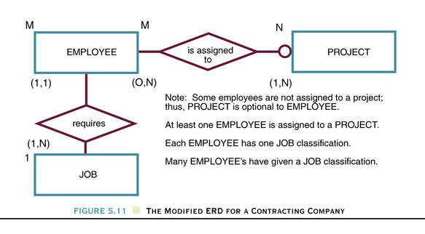
The Modified ERD

Slide 31
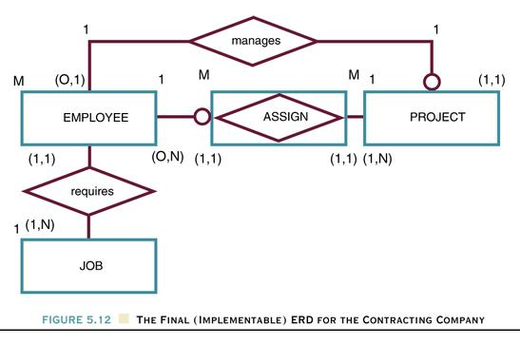
Creation of Composite Entity ASSIGN

Slide 32
Normalization and Database Design
Attribute ASSIGN_HOUR is assigned to the composite entity ASSIGN.
“Manages” relationship is created between EMPLOYEE and PROJECT.
    PROJECT (PROJ_NUM, PROJ_NAME, EMP_NUM)
    EMPLOYEE (EMP_NUM, EMP_LNAME, EMP_FNAME, EMP_INITIAL,
    EMP_HIREDATE, JOB_CODE)
    JOB (JOB_CODE, JOB_DESCRIPTION, JOB_CHG_HOUR)
    ASSIGN (ASSIGN_NUM, ASSIGN_DATE, PROJ_NUM, EMP_NUM,
    ASSIGN_HOURS)

Slide 33
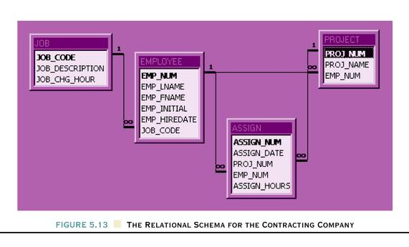
Relational Schema

Slide 34
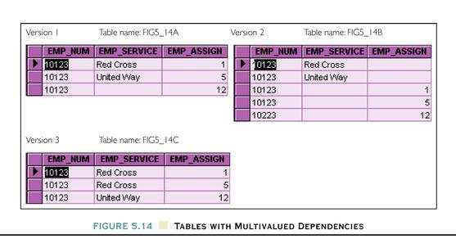
Higher-Level Normal Forms
4NF Definition
  A table is in 4NF if it is in 3NF and has no multiple sets of multivalued dependencies.

Slide 35
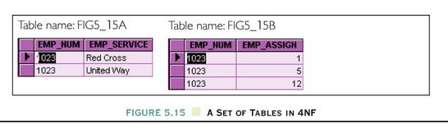
A Set of Tables in 4NF

Slide 36
Denormalization
Normalization is only one of many database design goals.
Normalized (decomposed) tables require additional processing, reducing system speed.
Normalization purity is often difficult to sustain in the modern database environment. The conflict between design efficiency, information requirements, and processing speed are often resolved through compromises that include denormalization.

Slide 37
SUMMARY

Slide 38
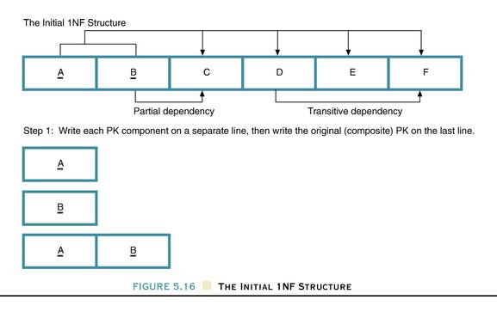
The Initial 1NF Structure

Slide 39
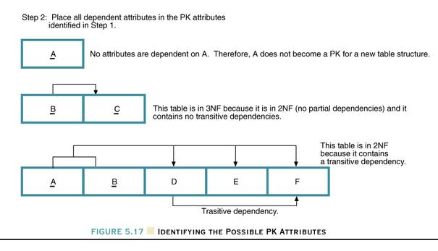
Identifying the Possible PK Attributes

Slide 40
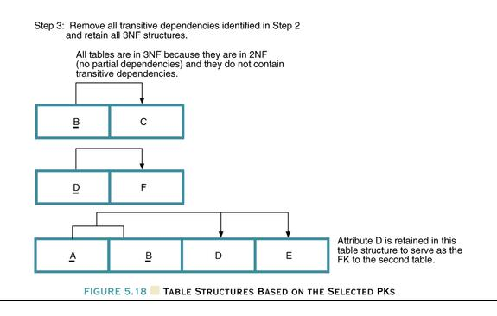
Table Structures Based On
The Selected PKs

